Slide 1

Blockchain
Privacy and Security
https://youtu.be/SxWWeB5luSE
https://youtu.be/_6SQNu6ZUAs
Notes:
요즘 블록체인은

Slide 2

Pros and Cons
Pros
Data integrity
Decentralizing
→ All user have the same data
Cons
Security
Privacy
Notes:
블록체인은 구조적으로 암호학적인 해시함수를 사용하여 데이터들을 검증할 수 있게 하는데요.

Slide 3
Privacy Invasion
Public ledger ( Bitcoin, Ethereum )
Opened database
Transaction
Pseudonymity
Address
→ Usage Analysis
Private ledger ( Hyperledger )
Permissioned database
Real-name system
Can’t be preserved
Notes:
비트코인, 이더리움에서 살펴볼 수 있었듯
블록체인은 명백한 프라이버시 침해 문제를 갖습니다.

Slide 4
Why Privacy?
GDPR ( General Data Protection Regulation )
Privacy policy in EU
Trends
Blockchain Application
Diverse use case

Slide 5


Use case
 | CCTV A | CCTV B | CCTV C
Traffic Accident | Yes | Yes | Yes
Violence | No | No | Yes
CCTV cooperation
Peer review system
Emission trading scheme
Data
Integrity of video
Expectation
Reliability
Scalability
Privacy

Slide 6





Use case
External storage
CCTV cooperation
Peer review system
Emission trading scheme
Expectation
Ethereum Network
Reliability
Scalability
Privacy

Slide 7


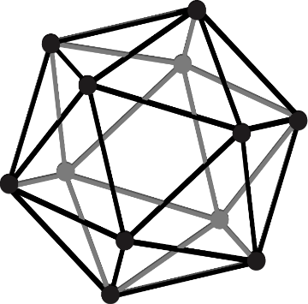



Use case
Traders
Government
CCTV cooperation
Peer review system
Emission trading scheme
Hyperledger
Specialist
Edge Node
Expectation
Plant
Reliability
Scalability
Privacy
Sensors

Slide 8
How to Preserve?
Add something to existing blockchain
Create new blockchain
Zero-knowledge

Slide 9


Method
UTXO ( Unspent transaction output )
UTXO
Mixing
Ring signature
Zero-knowledge
Alice
Bob
1 BTC
1 BTC
2 BTC
2 BTC
5 BTC
3 BTC
Bitcoin

Slide 10

Method
Mixing
UTXO
Mixing
Ring signature
Zero-knowledge
Alice
Master Node
Bob
1 DC
Mixing
1 DC
2 DC
5 DC
5 DC
Dash

Slide 11

Method
Ring signature
UTXO
Mixing
Ring signature
Zero-knowledge
Alice, Cosmos, Doritos
Bob
1 MC
1 MC
2 MC
5 MC
5 MC
Monero

Slide 12

Method
Zero-knowledge
Bitcoin Tx
UTXO
Mixing
Ring signature
Zero-knowledge
Wallet A sent 3 BTC to wallet B on May 5th
. . .
Zcash Tx
Wallet X sent X ZEC to wallet X on May 5th
. . .
Zcash

Slide 13
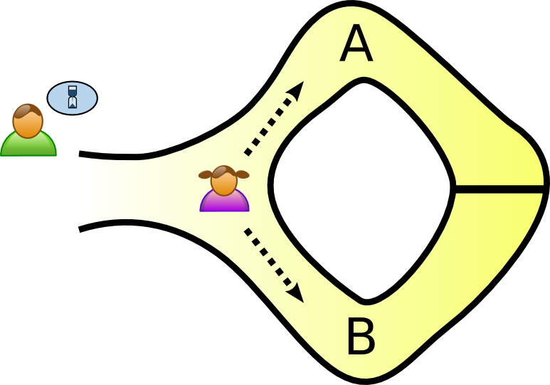
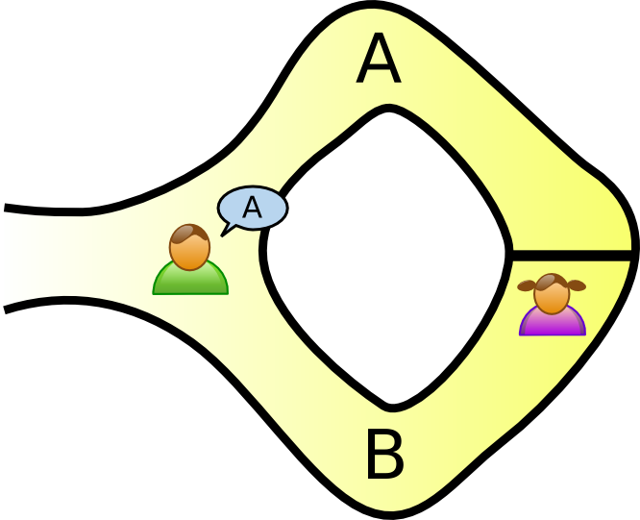
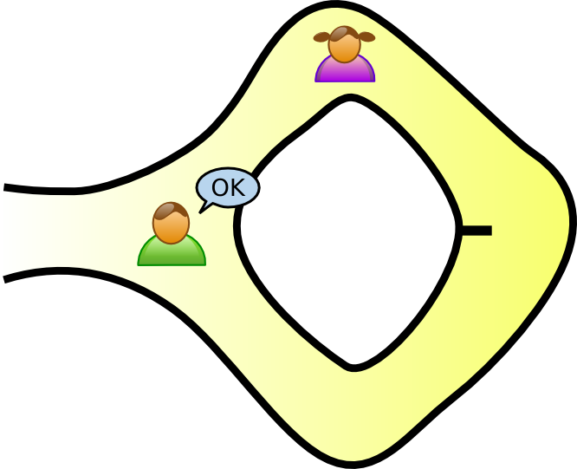
Zero-Knowledge Proof ( ZKP )
STEP 1
STEP 2
STEP 3
Verifier
Prover
Statement
“ Prover knows the password ”
Door lock

Slide 14
ZKP Family
ZK-SNARKs
Succint Non-interactive ARgument Knowledge
ZK-STARKs
Succint Transparant ARgument Knowledge

Slide 15


ZK-SNARKs Overview
Computation → Arithmetic Circuit → Quadratic Arithmetic Program
Prove it
With Pinocchio Protocol ( Evaluation )
With Pairing in Elliptic Curve Cryptosystem ( Hiding Evaluation )
$$×$$
$L≔ \sum_{1}^{5}{C_{i}∙L_{i}}$, $R≔ \sum_{1}^{5}{C_{i}∙R_{i}}$, $O≔ \sum_{1}^{5}{C_{i}∙O_{i}}$
$${ (C}_{1}∙C_{2})∙(C_{1}+C_{3})=7$$
$$×$$
$$+$$
$${ C}_{1}$$
$${ C}_{2}$$
$${ C}_{3}$$

Slide 16
ZK-STARKs Intro
SNARKs Assumption
ECC Pairing
Vulnerable from Quantum Algorithms
STARKs Assumption
Merkle Tree
Safe from Quantum Algorithms
Increase Size of Proof ( hundreds of byte to hundreds of kilobyte )

Slide 17
Merkle Tree
SHA-256 ( Hash function )
One way, Fixed output size
Validation
Merkle root
Hashed child nodes
Hashed Tx
Tx
Merkle Tree Structure

Slide 18
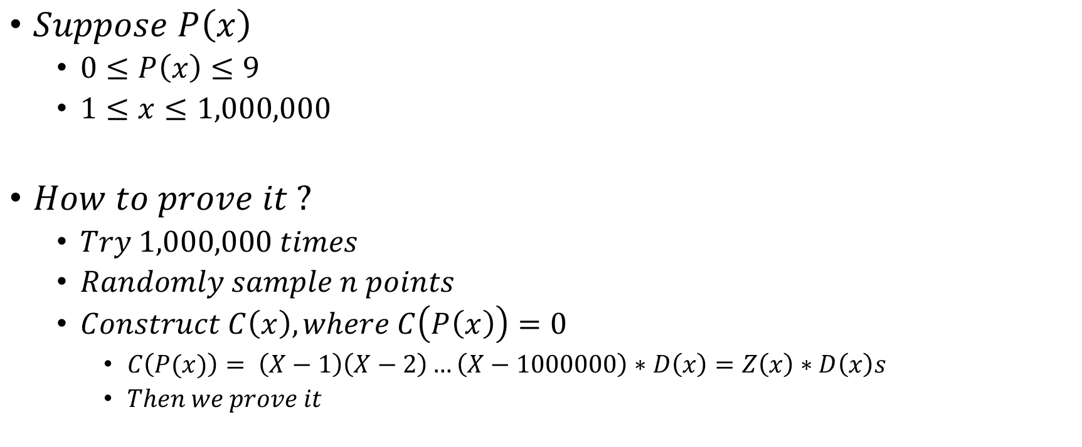
ZK-STARKs
$Suppose P\left(x\right)$
$0≤P\left(x\right)≤9$
$1≤x≤1,000,000$
$How to prove it ?$
$Try 1,000,000 times$
$Randomly sample n points$
$Construct C\left(x\right), where C\left(P\left(x\right)\right)=0$
$C\left(P(x)\right)= \left(X−1\right)\left(X−2\right)…\left(X−1000000\right)∗D\left(x\right)=Z\left(x\right)∗D\left(x\right)s$
$Then we prove it$

Slide 19
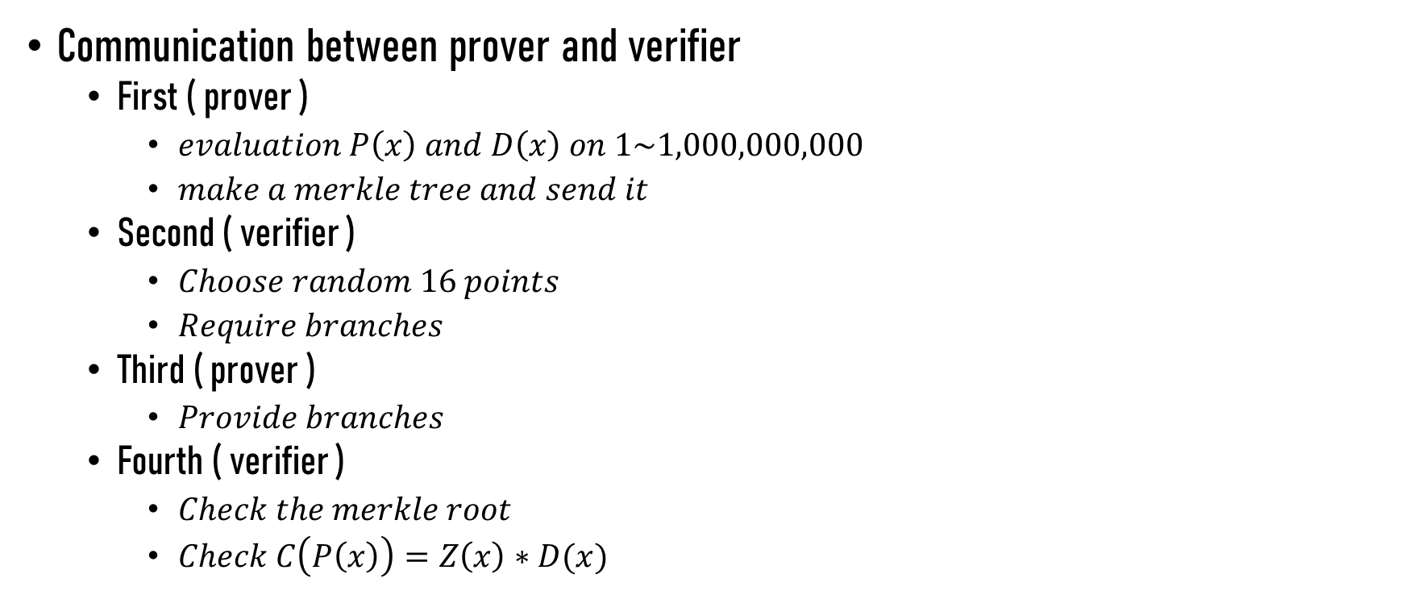
ZK-STARKs
Communication between prover and verifier
First ( prover )
$evaluation P\left(x\right) and D\left(x\right) on 1\sim 1,000,000,000$
$make a merkle tree and send it$
Second ( verifier )
$Choose random 16 points$
$Require branches$
Third ( prover )
$Provide branches$
Fourth ( verifier )
$Check the merkle root$
$Check C\left(P\left(x\right)\right)=Z\left(x\right)∗D(x)$

Slide 20
Privacy Communication
Covert Communication
Hiding relationship between two party
Hiding when communication is started
Covert Channel in Blockchain
Condition
Accessibility
Immutability
Reliability

Slide 21
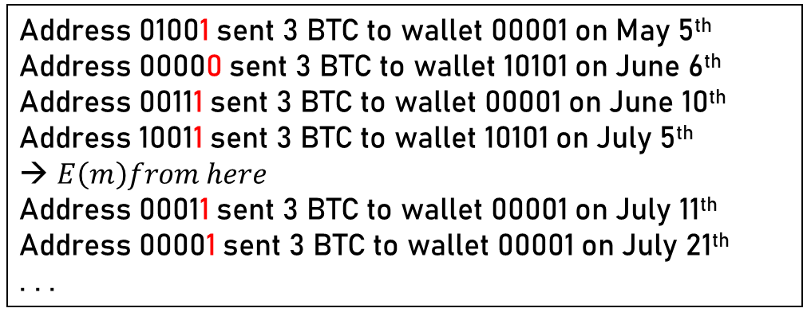




Covert Communication on Blockchain ( BLOCCE )
Transaction List
Encrypt Message
Start Indicator
Concatenate
Example
$λ is 1011$
Address 01001 sent 3 BTC to wallet 00001 on May 5th
Address 00000 sent 3 BTC to wallet 10101 on June 6th
Address 00111 sent 3 BTC to wallet 00001 on June 10th
Address 10011 sent 3 BTC to wallet 10101 on July 5th
$E\left(m\right)from here$
Address 00011 sent 3 BTC to wallet 00001 on July 11th
Address 00001 sent 3 BTC to wallet 00001 on July 21th
. . .
$$E(m)$$
$$λ$$
$$λ$$
$$E(m)$$
Security Proof
Using history of Alice’s payment
→ Indistinguishibility

